Slide 1

Physics-Informed Neural Network (PINN)
Alec Snodgrass
May 04, 2026

Slide 2
Main Topics
PDE
PINN
Heat Equation
Machine Learning
Architecture
Analytical Solution
Results
Error
Sensitivity
Conclusion

Slide 3
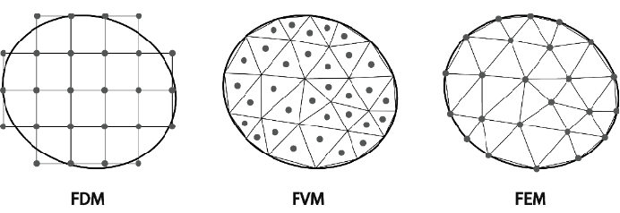
Motivation
Partial Differential Equations
Describes evolution of physical systems
Waves, heat, electromagnetics, etc.
Method | Approach | Pros | Cons
Finite Difference Method (FDM) | Approximates derivatives on a discretized grid | Fast and simple | Needs to be a simple problem
Finite Element Method (FEM) | Minimizes error of piecewise approx. made up of ‘elements’ (shapes) | Handles complex geometries | Mesh generation (high cost)
Finite Volume Method (FVM) | Balances fluxes across discretized volume elements | Obeys conservation laws | Complex for low accuracy and
PINN | Uses neural network to learn PDE. Low computational cost (relative) | High dimension, flexible integration, mesh free | Expensive training May not convergence
Notes:
Figure: https://www.researchgate.net/figure/Concepts-of-primary-discretization-methods_fig1_378859570

Slide 4
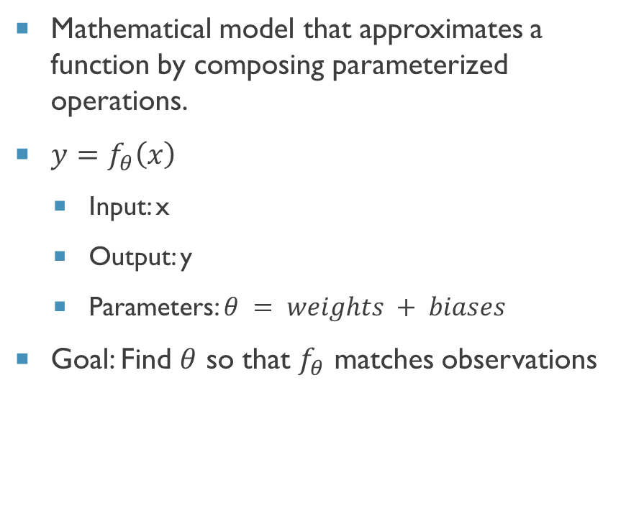
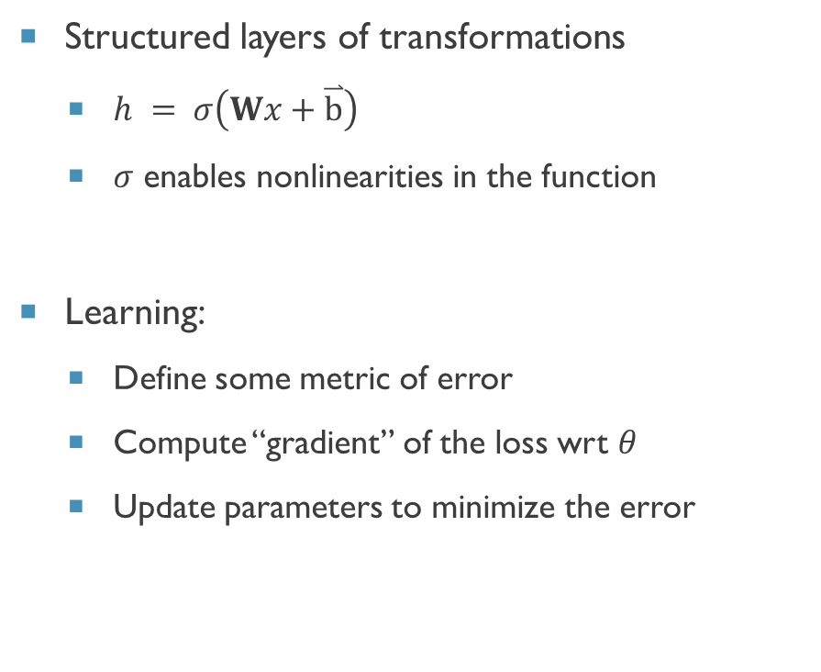
Neural network
Mathematical model that approximates a function by composing parameterized operations.
$y=f_{θ}\left(x\right)$
Input: x
Output: y
Parameters: $θ = weights + biases$
Goal: Find $θ$ so that $f_{θ}$ matches observations
Structured layers of transformations
$h = σ\left(Wx+\overset{⃑}{b}\right)$
$σ$ enables nonlinearities in the function
Learning:
Define some metric of error
Compute “gradient” of the loss wrt $θ$
Update parameters to minimize the error
Notes:
[Brody Codes AI](https://www.youtube.com/watch?v=WRSNrVH0wg8)

Slide 5
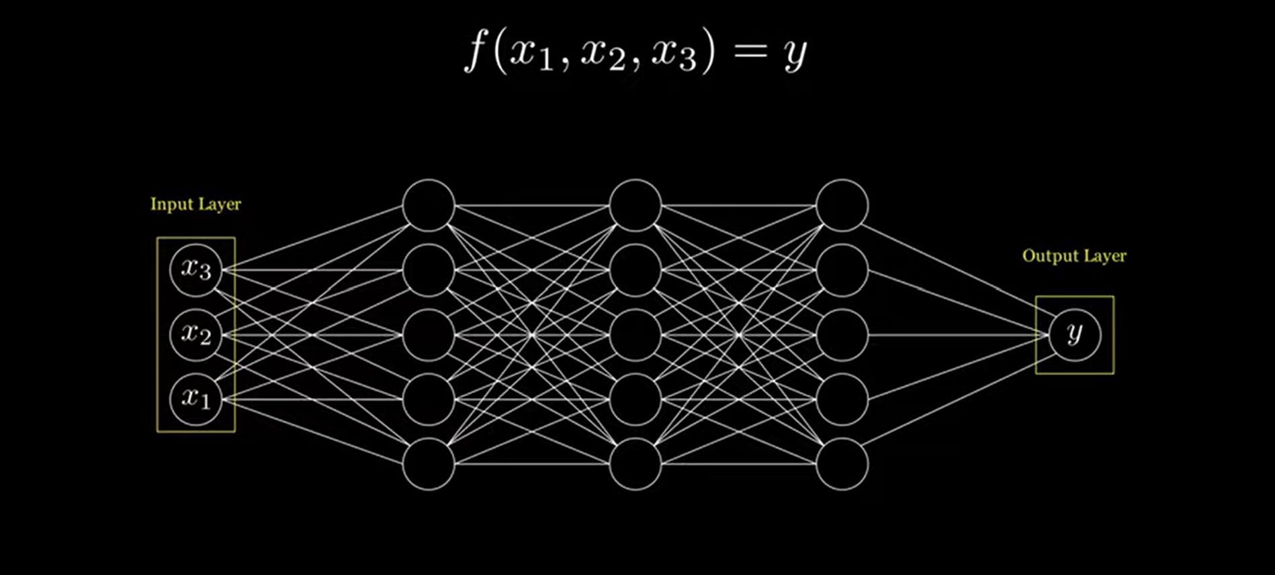
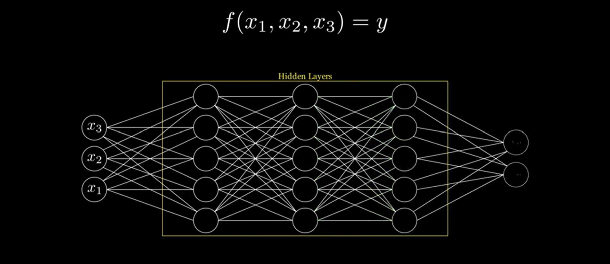
Physics-informed Neural network (pinn)
Approximates a solution
Training depends on more than data
Unlike standard machine learning
Enforce physics constraints, boundary conditions, and more
Physics enforced using PDE constraints during training
Finite Methods | Classical ML | PINN
Discretizes domain to solve | Fits solution to data points | Fits solution to data points + force solution to obey physics
Notes:
[Brody Codes AI](https://www.youtube.com/watch?v=WRSNrVH0wg8)

Slide 6
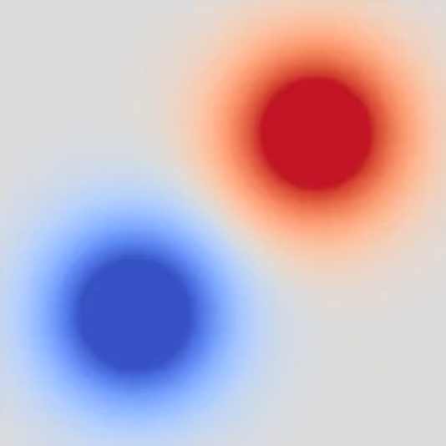
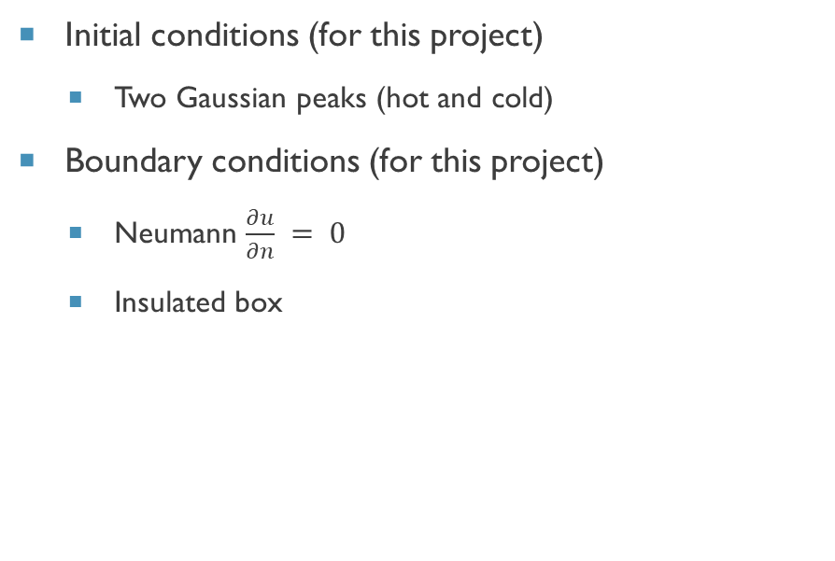
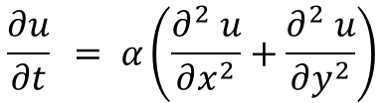
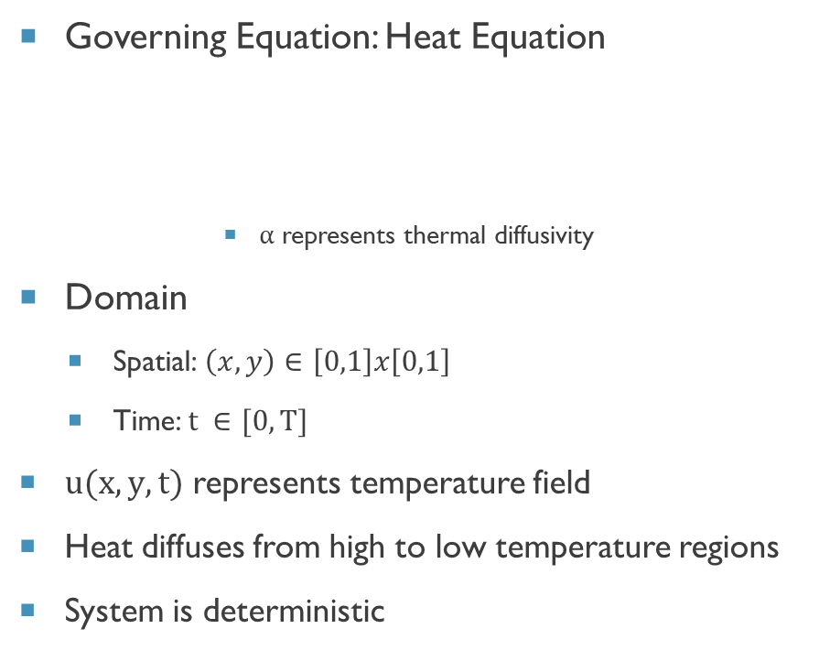
Specific Problem
Governing Equation: Heat Equation
$α$ represents thermal diffusivity
Domain
Spatial: $\left(x,y\right)∈\left[0,1\right]x\left[0,1\right]$
Time: $t ∈[0,T]$
$u(x,y,t)$ represents temperature field
Heat diffuses from high to low temperature regions
System is deterministic
Initial conditions (for this project)
Two Gaussian peaks (hot and cold)
Boundary conditions (for this project)
Neumann $\frac{∂u}{∂n} = 0$
Insulated box
$$\frac{∂u}{∂t} = α\left(\frac{∂^{2} u}{∂x^{2}}+\frac{∂^{2} u}{∂y^{2}}\right)$$

Slide 7
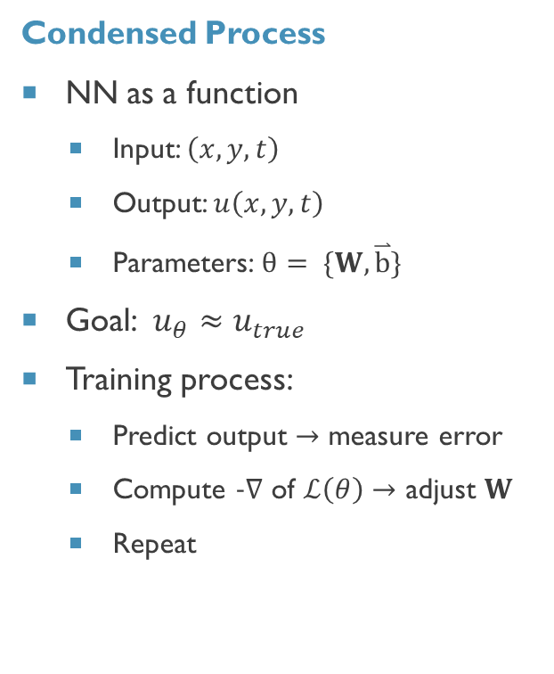
Neural Network Training (Overview)
Condensed Process
NN as a function
Input: $\left(x,y,t\right)$
Output: $u\left(x,y,t\right)$
Parameters: $θ= \{W,\overset{⃑}{b}\}$
Goal: $u_{θ}≈u_{true}$
Training process:
Predict output $→$ measure error
Compute $−∇$ of $ℒ\left(θ\right)→$ adjust $W$
Repeat
Vocabulary
Weight matrix
Bias vectors
Loss function
Gradient descent
Optimizer
Forward pass
Backpropagation
Intuition
NN = parameterized function
Training = curve fitting in high-dimensional space
Weights = shape of function, curvature, sensitivity to inputs

Slide 8
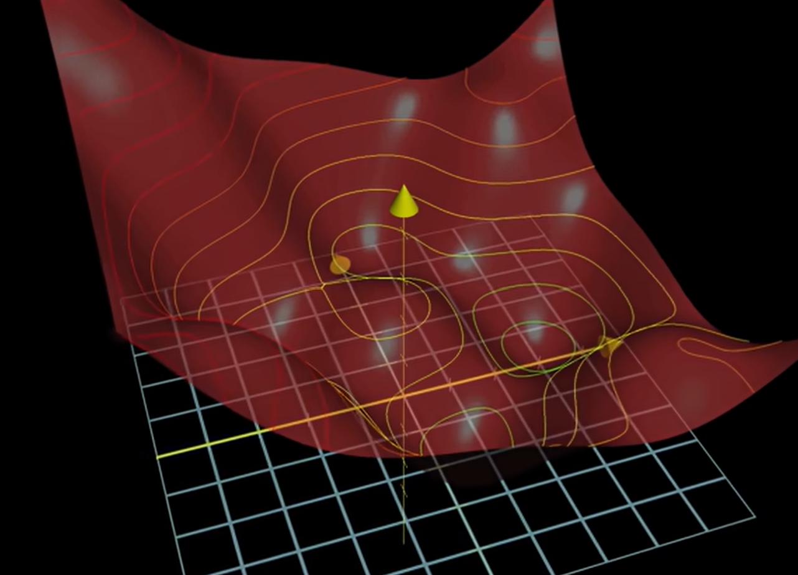
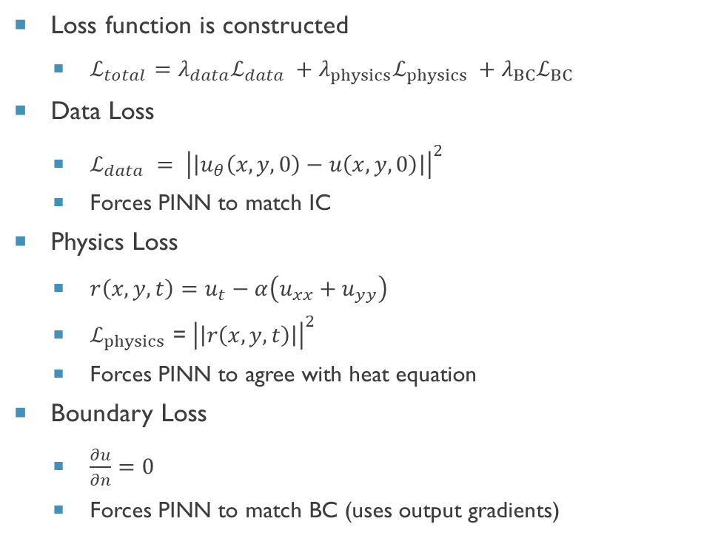
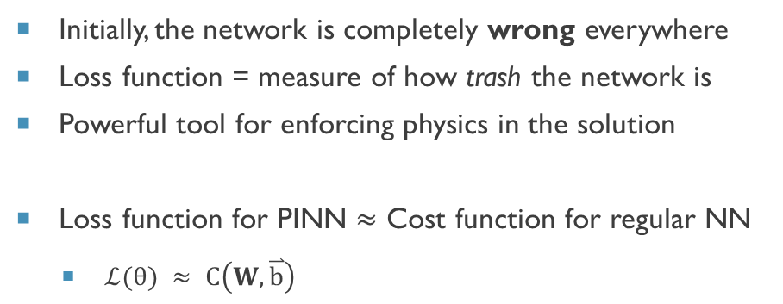
Loss (Cost) Function
Loss function is constructed
$ℒ_{total}=λ_{data}ℒ_{data} +λ_{physics}ℒ_{physics} +λ_{BC}ℒ_{BC}$
Data Loss
$ℒ_{data} = {\left|\left|u_{θ}\left(x,y,0\right)−u\left(x,y,0\right)\right|\right|}^{2}$
Forces PINN to match IC
Physics Loss
$r\left(x,y,t\right)=u_{t}−α\left(u_{xx}+u_{yy}\right)$
$ℒ_{physics}$ = ${\left|\left|r\left(x,y,t\right)\right|\right|}^{2}$
Forces PINN to agree with heat equation
Boundary Loss
$\frac{∂u}{∂n}=0$
Forces PINN to match BC (uses output gradients)
Initially, the network is completely wrong everywhere
Loss function = measure of how trash the network is
Powerful tool for enforcing physics in the solution
Loss function for PINN $≈$ Cost function for regular NN
$ℒ(θ) ≈ C\left(W,\overset{⃑}{b}\right)$
Notes:
https://www.knmsonic.com/wp-content/uploads/2024/04/Things-You-Need-To-Know-About-Ultrasonic-Plastic-Welding.png

Slide 9
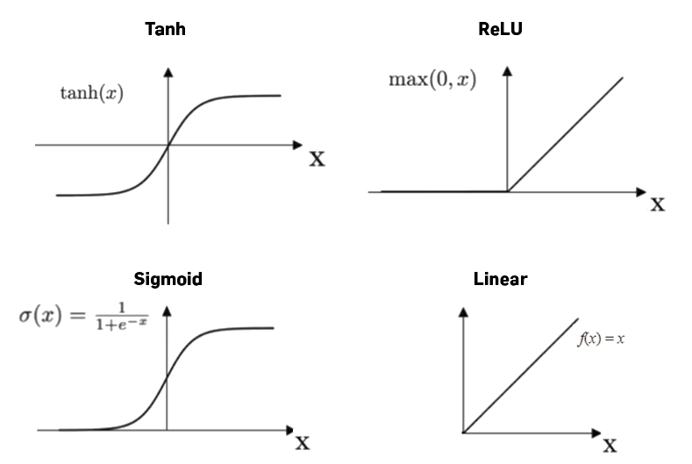
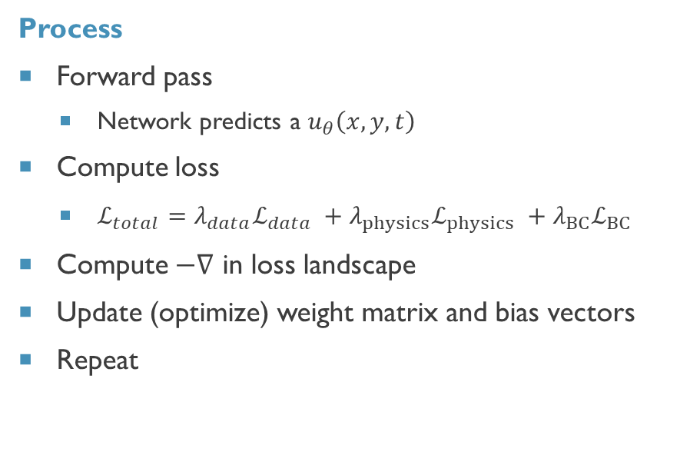
Neural Network Training (Process)
Process
Forward pass
Network predicts a $u_{θ}\left(x,y,t\right)$
Compute loss
$ℒ_{total}=λ_{data}ℒ_{data} +λ_{physics}ℒ_{physics} +λ_{BC}ℒ_{BC}$
Compute $−∇$ in loss landscape
Update (optimize) weight matrix and bias vectors
Repeat
Tools
Activation functions (shape of function)
Sigmoid
ReLU
Tanh
Gradient computer
Backpropagation
Auto differentiation
Optimizers
Stochastic Gradient Descent
Adam
Momentum methods
Notes:
https://machine-learning.paperspace.com/wiki/activation-function Activation functions add non-linearity to the output which enables neural networks to solve non-linear problems. In other words, a neural network without an activation function is essentially just a linear regression model.

Slide 10
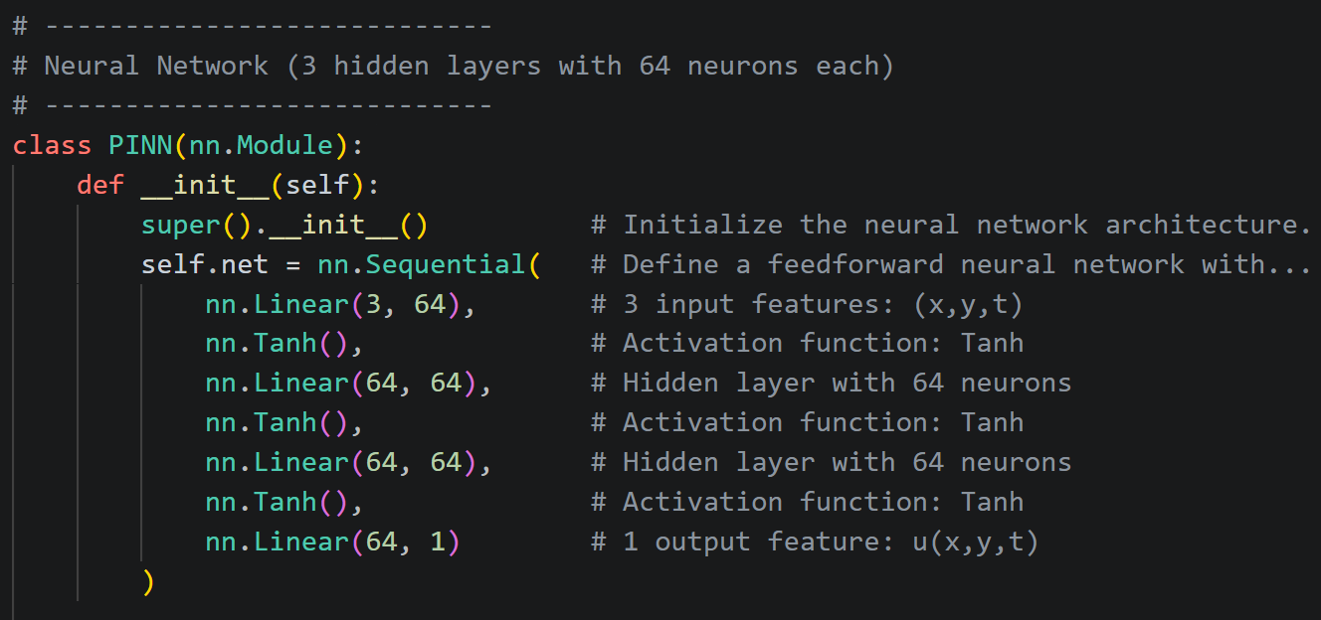
Architecture
3 layers
64 neurons
Activation function: Tanh
PyTorch does some neural network magic automatically
In-depth to understand
Convenient to implement
Notes:
https://atslab.com/wp-content/uploads/2024/07/Mechanical_Testing_Tensile_Test_Steel-1.jpg.webp

Slide 11
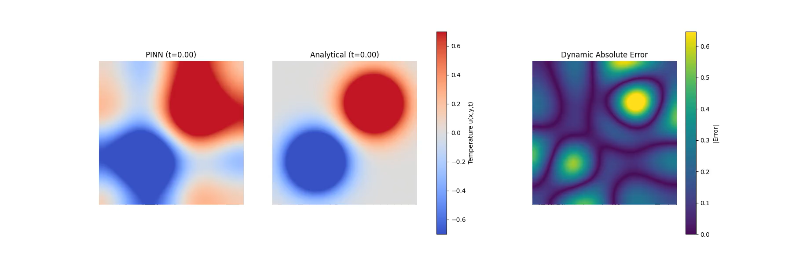
Results

Slide 12
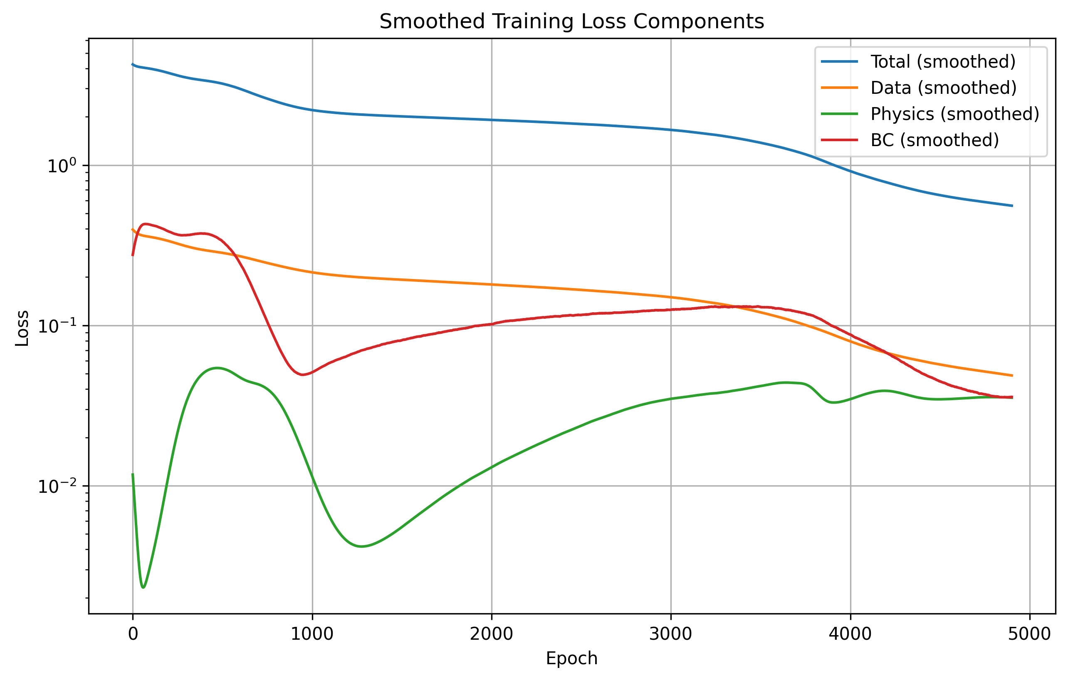
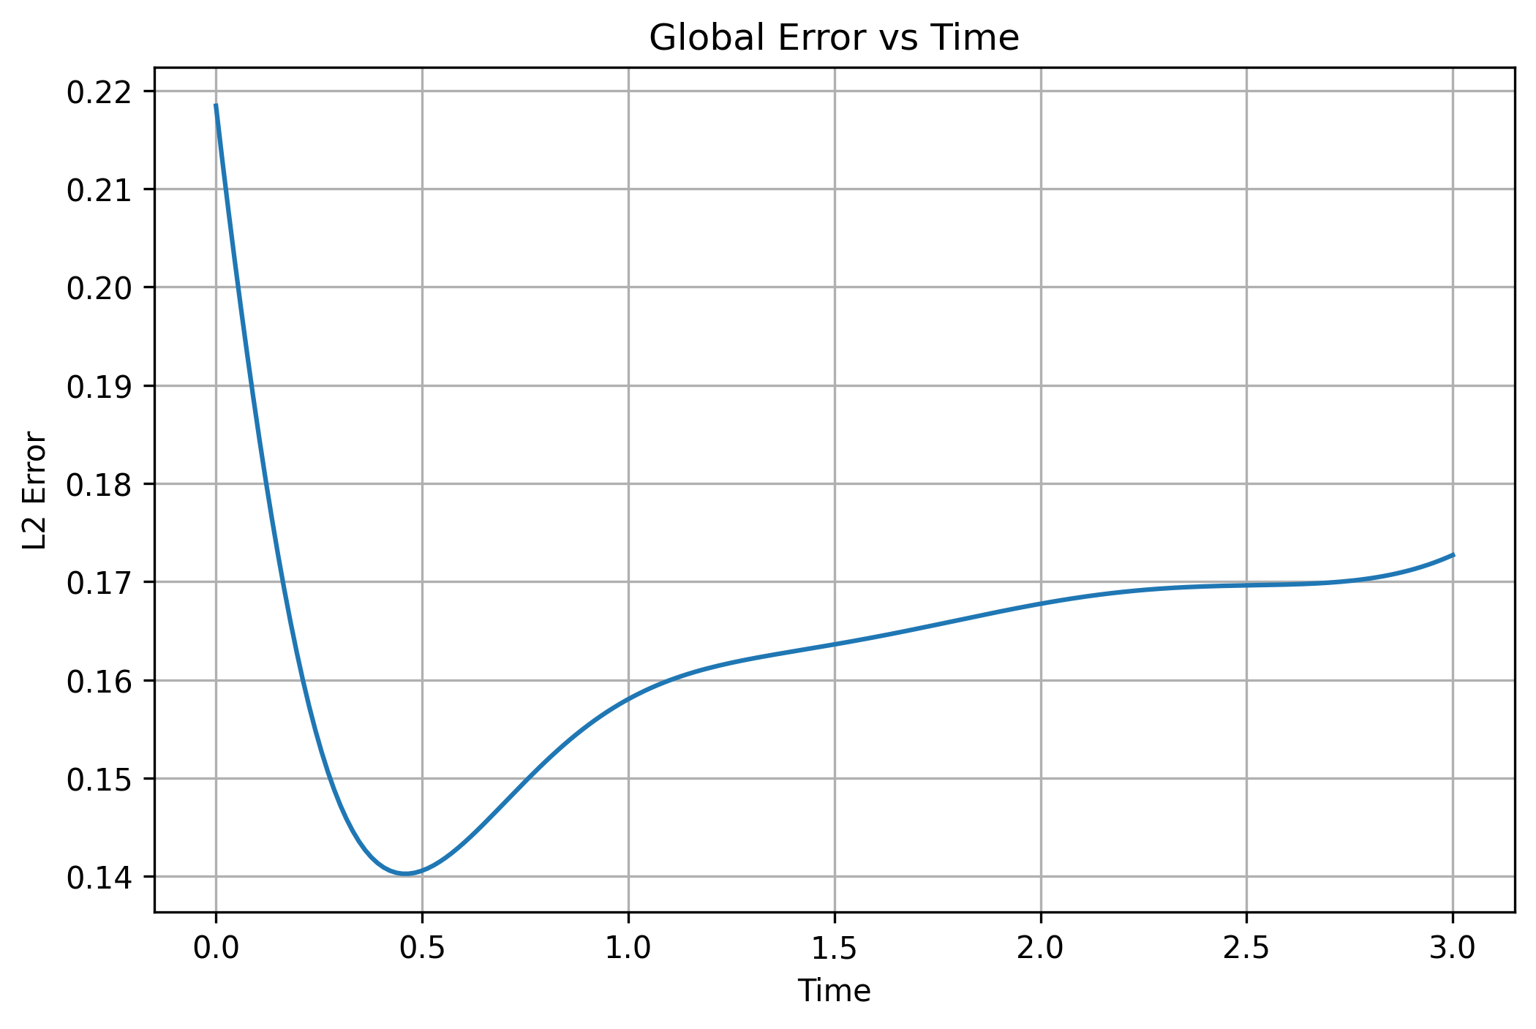
Training progress & Error

Slide 13
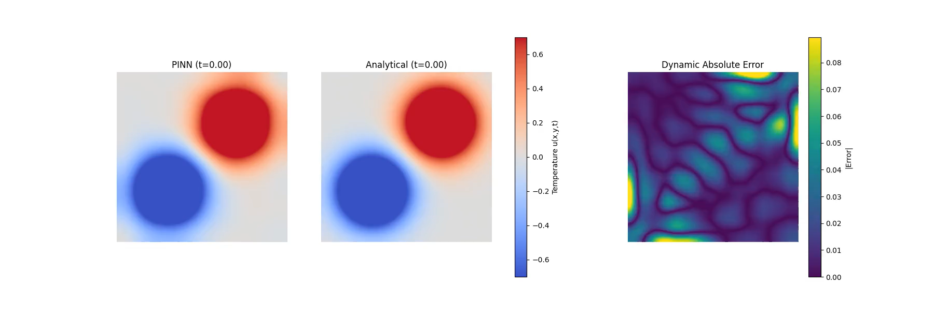
Results

Slide 14
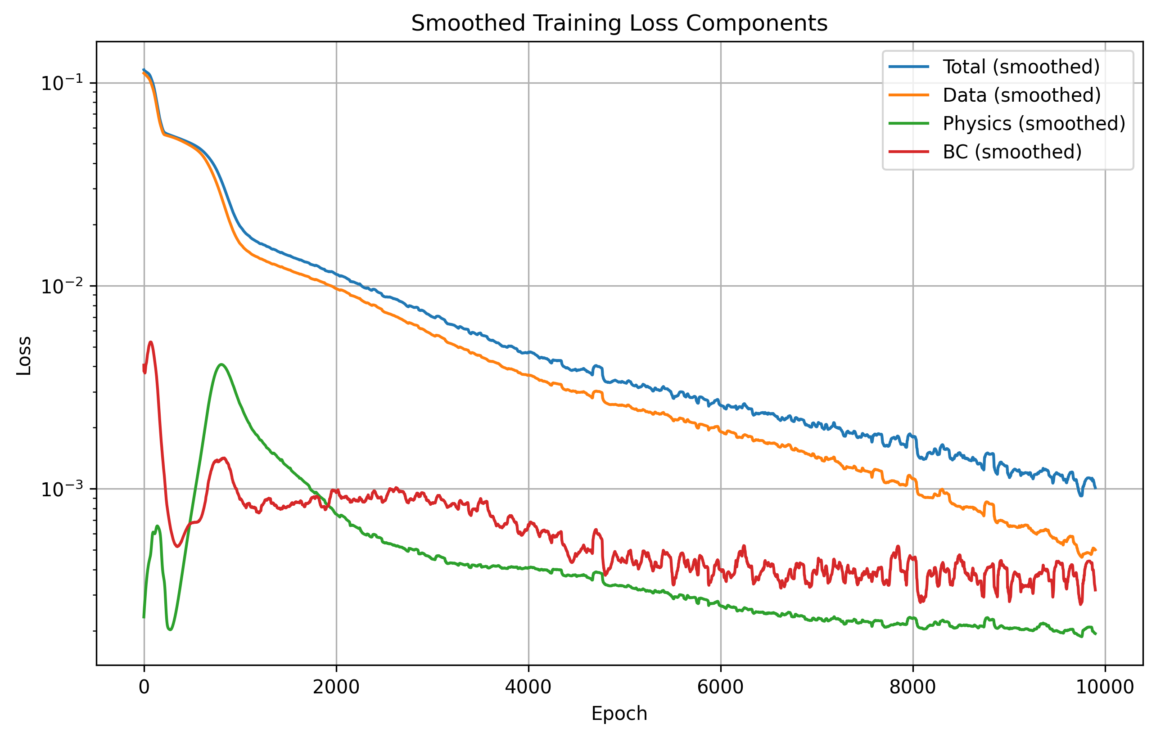
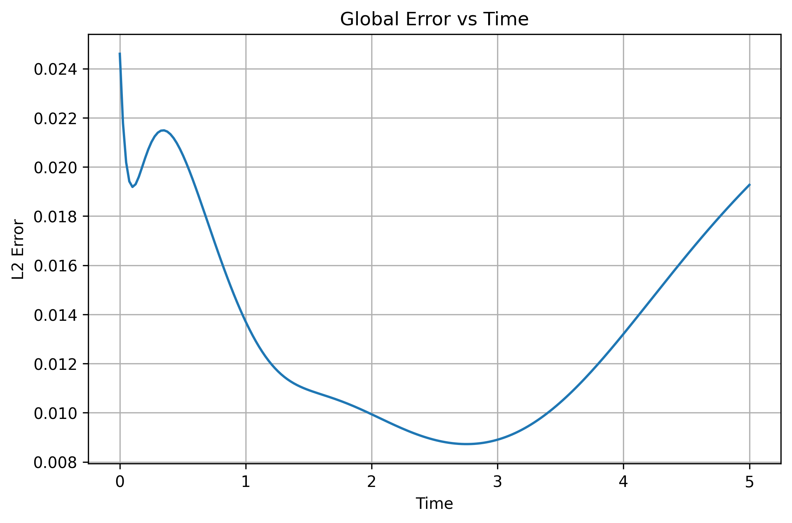
Training progress & Error

Slide 15

Questions?
Alec Snodgrass

Slide 16
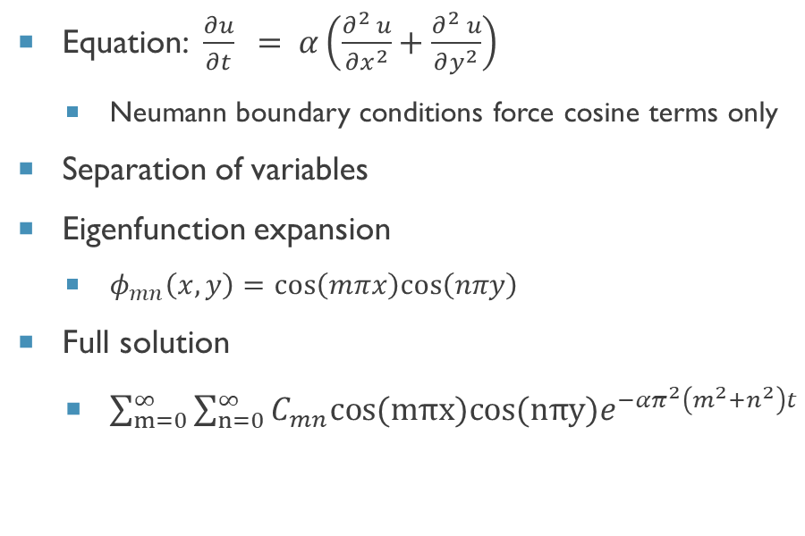
Analytical Solution
Equation: $\frac{∂u}{∂t} = α\left(\frac{∂^{2} u}{∂x^{2}}+\frac{∂^{2} u}{∂y^{2}}\right)$
Neumann boundary conditions force cosine terms only
Separation of variables
Eigenfunction expansion
$φ_{mn}\left(x,y\right)=cos\left(mπx\right)cos\left(nπy\right)$
Full solution
$\sum_{m=0}^{∞}{\sum_{n=0}^{∞}{C_{mn}cos(mπx)cos(nπy)e^{−απ^{2}\left(m^{2}+n^{2}\right)t}}}$
Not required for PINN to work
Required for error analysis
Series truncated (infinite series required for exact solution)

